Slide 1
Geography Review
Do you know all of the landforms?

Slide 2
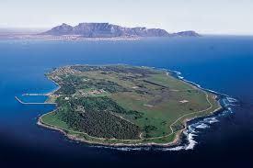
What is this landform?
island- a body of land surrounded by water

Slide 3
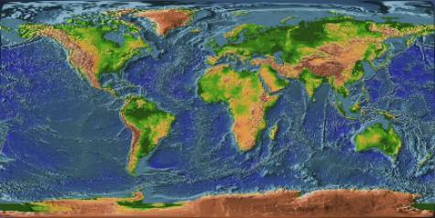
What is this landform?
continent- one of 7 great land masses on Earth

Slide 4
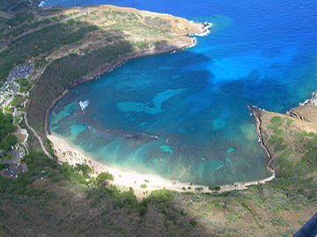
What is this body of water?
bay-a body of water that extends into land

Slide 5
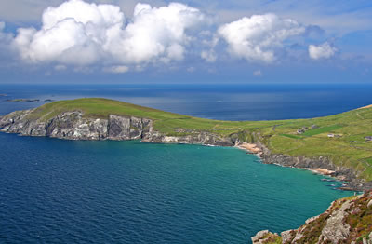
What is this landform?
peninsula- a body of land surrounded by water on 3 sides

Slide 6
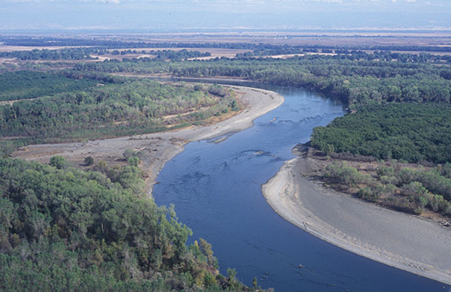
What is this body of water?
river- a body of water that flows through land

Slide 7
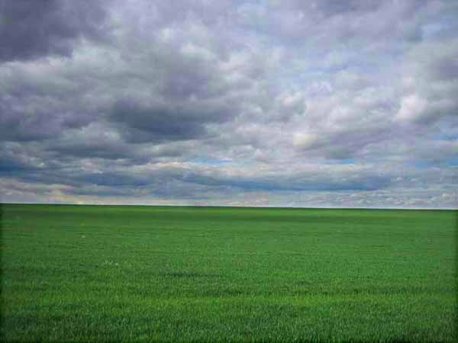
What is this landform?
plains- a large, low area of flat or rolling land with few trees

Slide 8
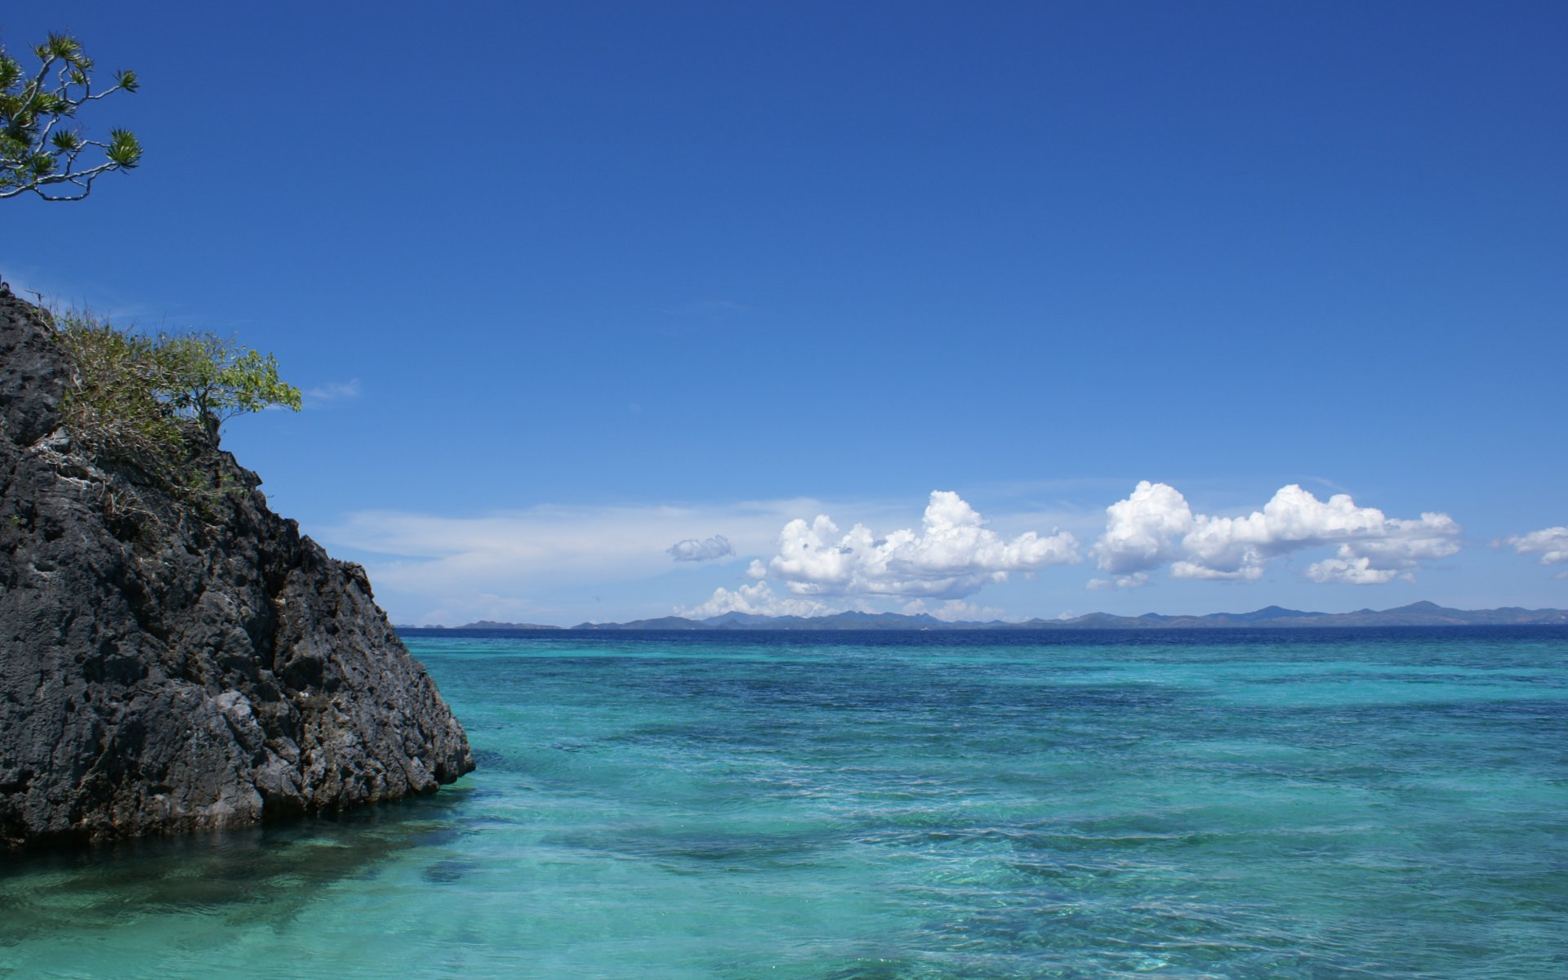
What is this body of water?
Ocean-a body of salt water that covers most of Earth

Slide 9
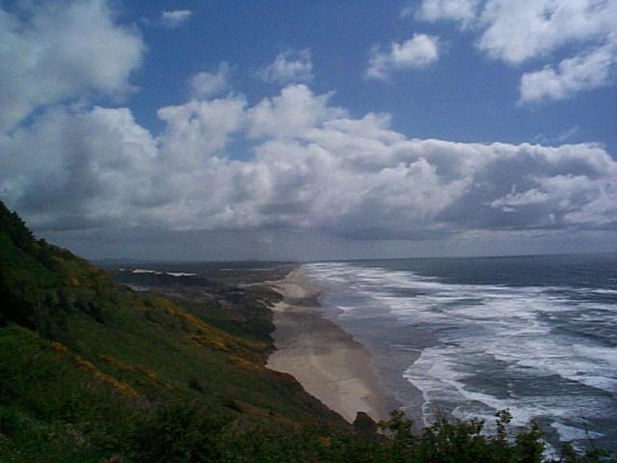
What is this landform?
coast- a rocky or sandy edge along a body of water

Slide 10
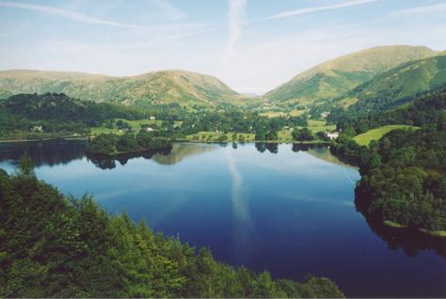
What is this landform?
lake- an inland body of water

Slide 11
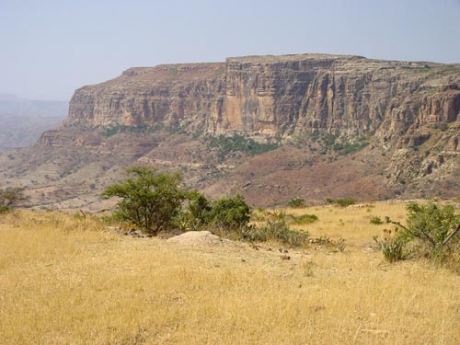
What is this landform?
plateau- land that is high and flat on top

Slide 12
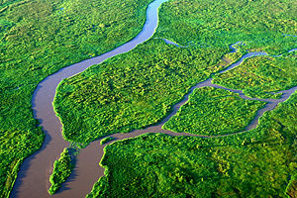
What is this body of water?
tributary- a stream flowing into a larger body of water

Slide 13
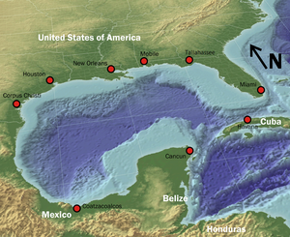
What is this body of water?
gulf- a large body of salt water that is partly enclosed by land

Slide 14
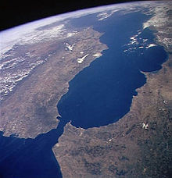
What is this body of water?
strait- a narrow body of water that connects 2 larger bodies of water

Slide 15
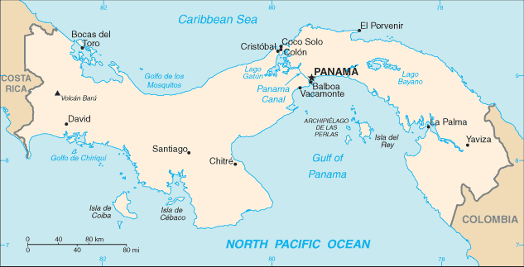
What is this landform?
Isthmus- a narrow strip of land, bordered on both sides by water, connecting two larger bodies of land

Slide 16
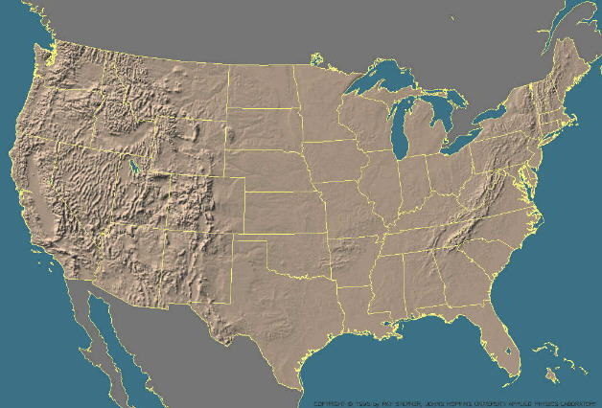
What is this landform?
The Great Plains

Slide 17
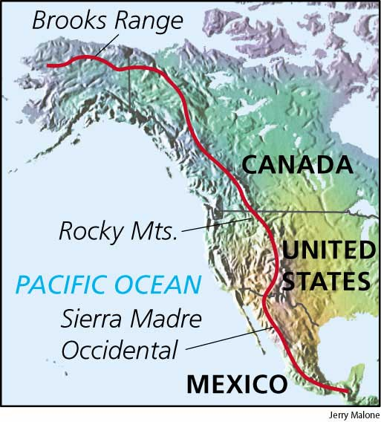
What is this landform?
The Continental Divide

Slide 18
What is this landform?
The Atlantic Coastal Plain

Slide 19
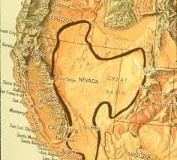
What is this landform?
The Great Basin

Slide 20
What is this landform?
Death Valley

Slide 21
What is this body of water?
St. Lawrence River

Slide 22
What is this landform?
Gulf of Mexico

Slide 23
What are these bodies of water?
Great Lakes

Slide 24
What are the names of the 5 Great Lakes?
H- Huron
O- Ontario
M- Michigan
E- Erie
S- Superior

Slide 25
GREAT! You know your landforms!

