Slide 1
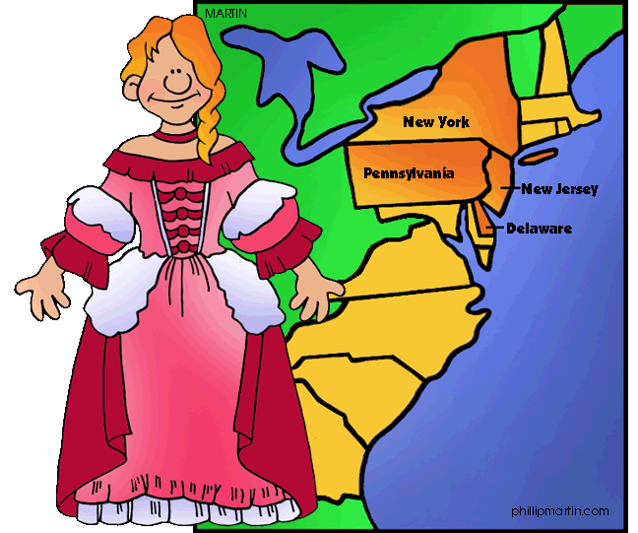
The Mid-Atlantic Colonies

Slide 2
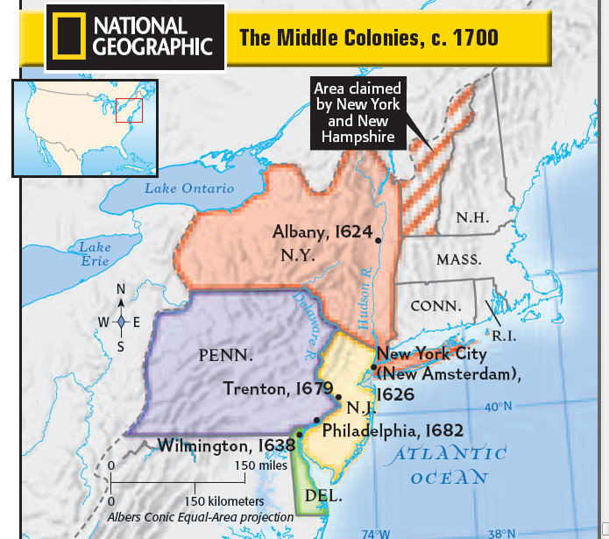
Mid-Atlantic Colonies
New York
Pennsylvania
New Jersey
Delaware

Slide 3
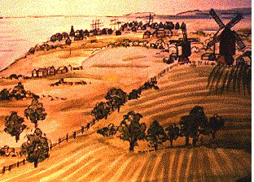
Mid-atlantic Geography
Known as the middle colonies because they were between the New England colonies and Virginia
Flat plains
Rolling hills
Grassy meadows
Thick forests
Good climate for growing crops
Land such as this helped the
Mid-Atlantic colonies become the
“breadbasket” colonies because so
many of the crops were used to make bread
Atlantic Ocean- this region had several harbors on the coast
Rivers- harbors were connected to the Hudson and Delaware rivers, making trading easier since ships could come inland

Slide 4
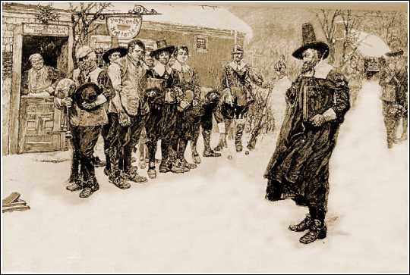
Mid-atlantic People
Diversity
People came from all
over to settle here
(Dutch, French, Belgian, Swedish,
English Puritans, Quakers,
German, Irish, Scottish)
Immigrants-
a person who comes into a country to make a new life
Reasons- escaping war, find religious freedom, better economic opportunities, more freedom
Free time-
City- enjoyed plays, concerts, horse races
rural- barn raisings
Famous people of the Mid-Atlantic colonies
William Penn, Benjamin Franklin

Slide 5
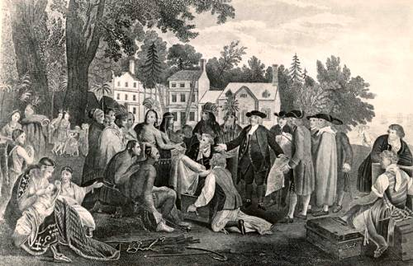
Mid-atlantic religion
Quakers-
Believed all people were equal
Refused to fight in wars or swear loyalty to a king or country
A.k.a. the Society of Friends
Treated Native Americans with justice and fairness
The Great Awakening
Religious movement that renewed peoples’ interest in
religion
More toleration of religious differences
Many different kinds of churches
Religion was a part of social life as well
Religion helped people see that slavery
was wrong

Slide 6
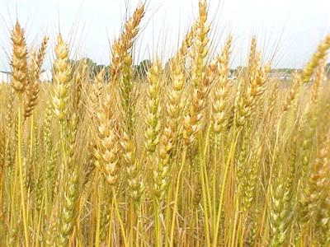
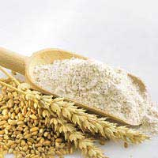
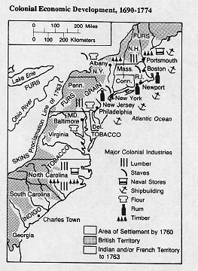
Mid-Atlantic-Economy
Crops
Wheat, corn, rye
Livestock
Dairy cows, pigs
Trade
Livestock, crops
What was in the market town?
Gristmill- grinds grains into flour
Lumber mill
General store- items they couldn’t
trade for like buttons, iron tools, shoes, paint

Slide 7
Mid-Atlantic-Economy
Port Cities- Major trade center for the Mid-Atlantic colonies
New York City- one of the most important port cities off the Hudson River. Farmers, fur traders, and lumber workers could float their goods down the river to New York City and the port’s harbor was a good place for boats to dock. NYC was the second busiest port in the colonies
Philidelphia- this was the busiest port in the colonies, built on the Delaware river. Farmers, merchants, and traders in Pennsylvania, New Jersey, and Delaware depended on this port because they sent goods or crops to the merchants here
Imports and Exports
Most all trade was between England and other English colonies
New England and the Mid-Atlantic exported many of the same products, except the Mid-Atlantic exported more wheat and grain
Most imports to the Mid-Atlantic came from England. Ships brought furniture, tea, gunpowder, medicines, and metal. Some ships carried enslaved Africans. Most of these people were made to work as craftworkers or servants.

Slide 8
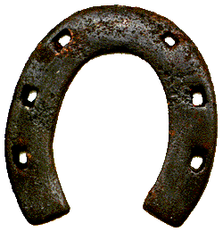
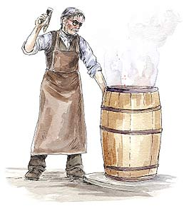
Mid-Atlantic-Colonial Jobs
artisans= craftworkers
Artisans often came as indentured servants
Blacksmiths- used iron to form horeshoes and tools
Coopers- made barrels out of wood
Carpenters- used wood to build houses and ships
Bricklayers- worked with stone and clay to pave streets and raise buildings
Apprentice= a young person who lived and worked with a family for several years to learn a skill
Practiced by men
Could later become a journeyman and earn a living and then a master
Women and girls had fewer chances to work outside the home
Few women owned property or businesses- the husband was the owner of everything
Sometimes if a woman’s husband died, then she could run his business

