Slide 1
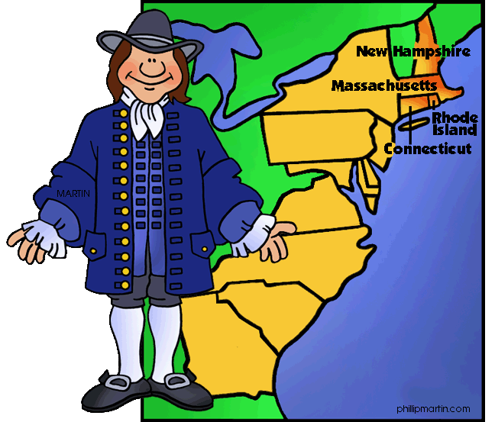
The New England Colonies

Slide 2
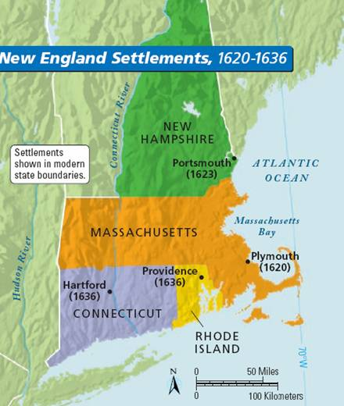
New England- Colonies
Massachusetts
Connecticut
New Hampshire
Rhode Island

Slide 3
New England- Geogrpahy
Atlantic Coast
Most lived near the coast to make it easier to get to ships for trade
Rivers
The logging industry used rivers to help move logs to coastal towns
Rocky soil
Colonists left to find better farmland- Connecticut River Valley
Cold harsh winters
*the winters and soil made farming difficult

Slide 4
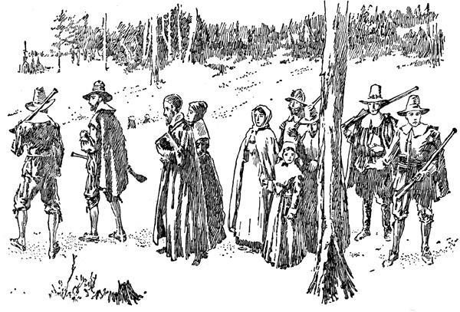
New England- People
Puritans-
Strict religious beliefs
Lives revolved around
work and prayer
Fun and games were a waste of time
Religious services were held in the Meeting House
Meeting house- simple house without paintings, stained glass windows, or statues
Voting- only allowed for free, white men who owned property

Slide 5
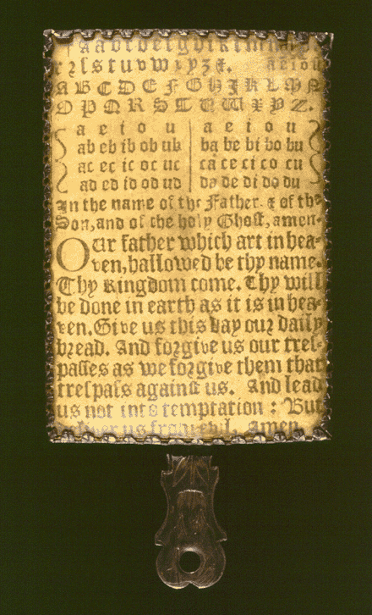
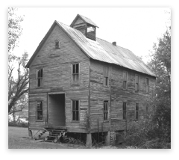
New England- School
School was important to the Puritans because they
believed everyone should read the Bible.
At first, children were taught at home. Then many
colonies passed a law that towns with 50 families
or more should have a school.
Schools were one room houses and the teachers were very strict.
There were no books or ink for paper because it was very costly. Students studied with a Hornbook, a piece of paper attached to a paddle-shaped frame that showed the alphabet.
Children did not go to school for long because they were needed for work.
Some boys continued their education. In
1636 the Puritans found Harvard College, now
Harvard University, to train ministers.

Slide 6
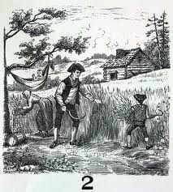
New England- Economy
Free market economy- people are free to choose which goods and services to sell and buy
Trade was at the center of the New England economy
English government set up strict rules that they could only import and export with England and the colonies
Little farming- hard winters and rocky land made it difficult
Farmers began raising dairy cows and sheep
Traded or sold surpluses of livestock, grain, wool,
and firewood at port cities
* Furs were also traded

Slide 7
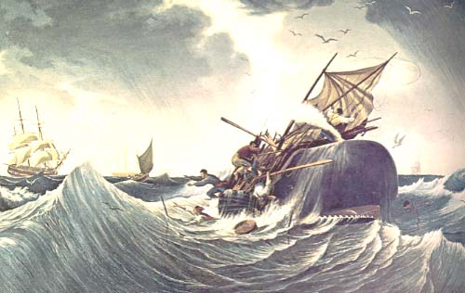
New England- Economy
Lumber- important industry
Used for naval stores to build ships
Ships were strong and were sent to
England
Lumber was sent to England
Fishing- also important for coastal towns
Fish- cod, herring, mackerel
Many fish- surplus was dried, packed in barrels, and sent to other colonies or England
Whaling
There were many whales off the coast
Whalers cut up the whales and boiled the blubber to get oil, used for lamps
Whales became scarce by the coast- whaling trips took longer and longer

