Slide 1
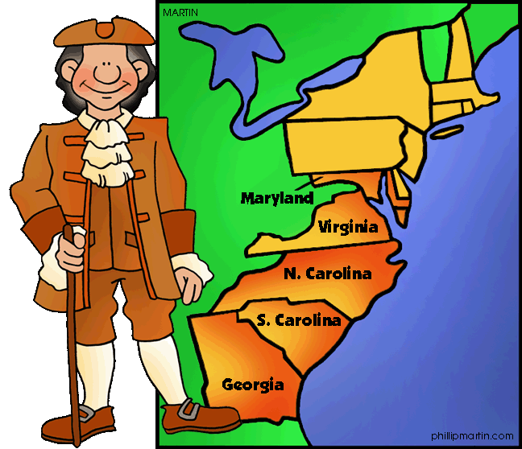
The Southern Colonies

Slide 2
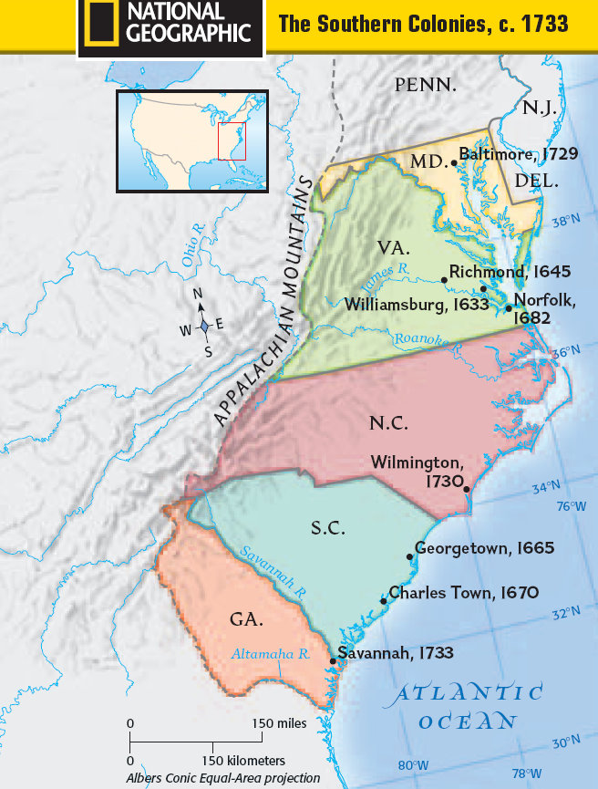
Southern Colonies
Maryland
Virginia
North Carolina
South Carolina
Georgia

Slide 3
Southern Geography
*Located between the coastal plains and the Appalachian mountains
*rivers, bays, steep hills
*mild climate
*land and weather was
good for farming

Slide 4
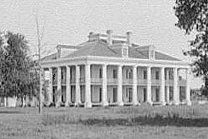
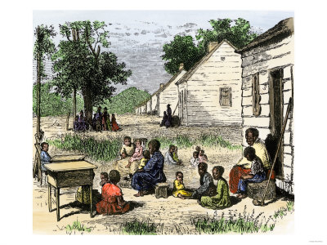
Southern People
Plantations-
large farms that looked like villages
Far away from neighbors
Planters or plantation owners were the
richest people in the Southern colonies
Owners lived in large houses
The plantations had many buildings and many people who worked there growing crops and caring for the land
Most of the work was done by enslaved Africans

Slide 5
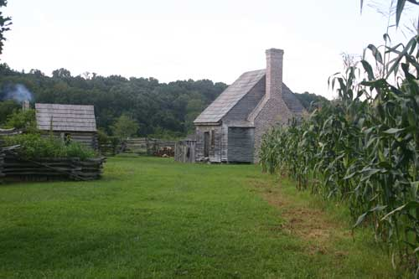
Southern People
Small Farms
People grew crops
Lived far from neighbors
Most of the colonists lived on small farms
Farmers did the work themselves
Lived in one story houses rather than mansions
Most did not have slaves working the land, but if they did, they worked beside them

Slide 6
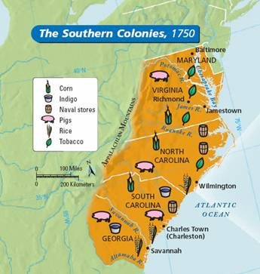
Southern Economy
Relied on farming
Mild climate and flat land made it possible to grow many different crops
Indigo- creates blue dye
Cotton
Tobacco
rice
Traded crops directly with Britain
rather than other colonies
Plantation owners, merchants, and
traders depended on one another
for economic resources=
interdependence

Slide 7
Southern Economy
Cash Crops
Virginia, Maryland, and North Carolina- tobacco
Tobacco required many workers
After 7 years the crop would have used all the nutrients in the soil, so it required more land to be cleared, thus the need for a lot of land
South Carolina and Georgia- indigo and rice
land was too wet, enslaved Africans were able to grow rice.
enslaved Africans made up a large part of the population
On drier land, indigo grew- a blue dye used in clothmaking
Industries- farming, shipbuilding
Plantations near rivers did best because they could ship their crops more quickly and easily

Slide 8
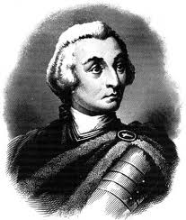
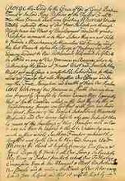
Georgia
England, Spain, and France all claimed the land below
South Carolina
King George of England wanted to send colonists there to start settling it
James Oglethorpe had an idea (and wrote a charter)
Send debtors (people who had been put in prison for owing money) to settle the new colony
Settlers would defend the land against other countries
Settlers would get a chance to start a new life
Called it Georgia in honor of the king
In 1733 the first group of colonists settled in Savannah
At first colonists were limited to small farms (no plantations) and slavery was not allowed
By 1751 Georgia’s leaders allowed slavery and as more enslaved Africans began working the farms, plantations were built

Slide 9
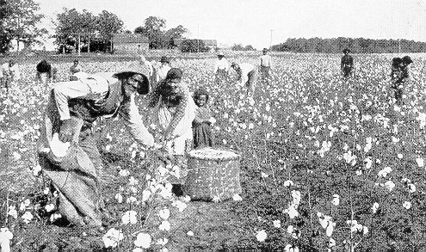
Slavery
For more than 300 years traders brought millions of Africans to North America, South America, and the Caribbean
The firs t Africans arrived in Virginia in 1619 and were indentured servants
By the mid 1700’s slavery was made legal in every colony because workers were needed
A law was made stating that children born to slaves would also be enslaved
Families were broken apart and sold to different owners
In the south, most slaves worked on plantations
Slaves were treatment depended on
their owners but they were often beaten
and abused
Slaves were not allowed to speak of
freedom but some would still try to
escape

